Slide 1

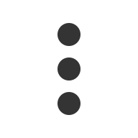
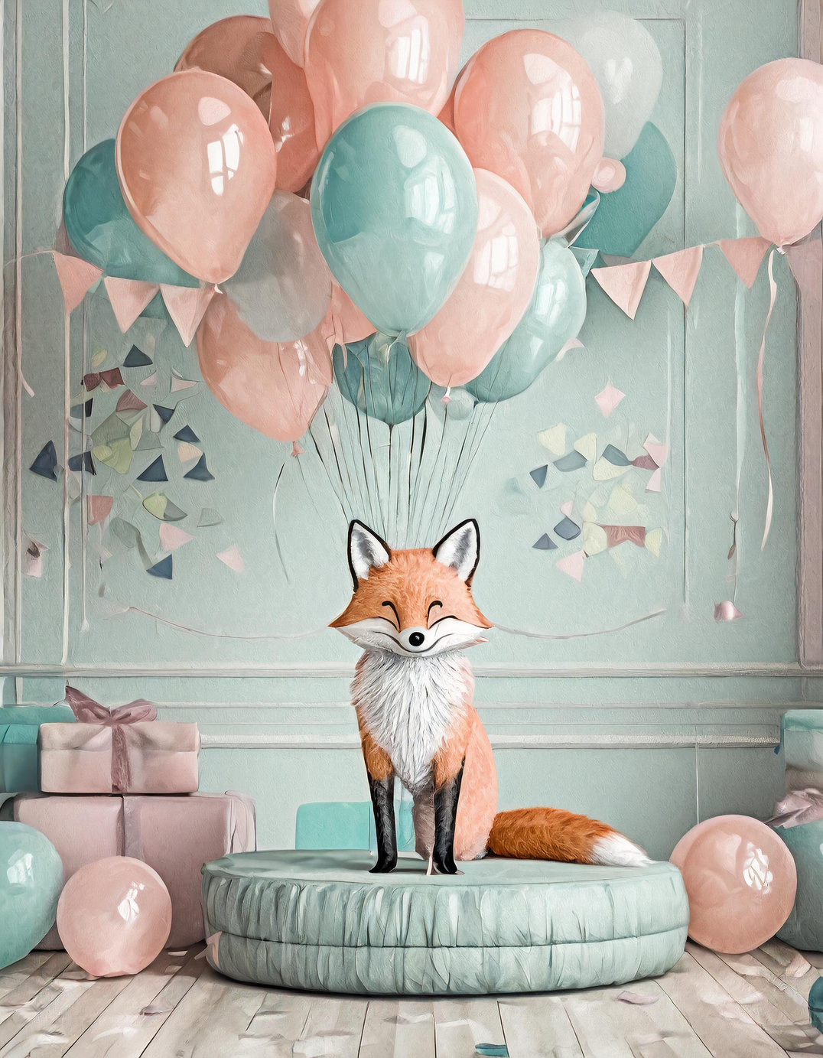
Fancy Fox Balloons
Integrated Communications Plan
Name: Kritika Sobti
Student Id: 8873442

Slide 2
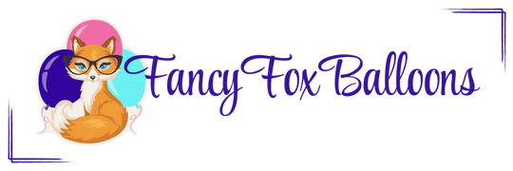


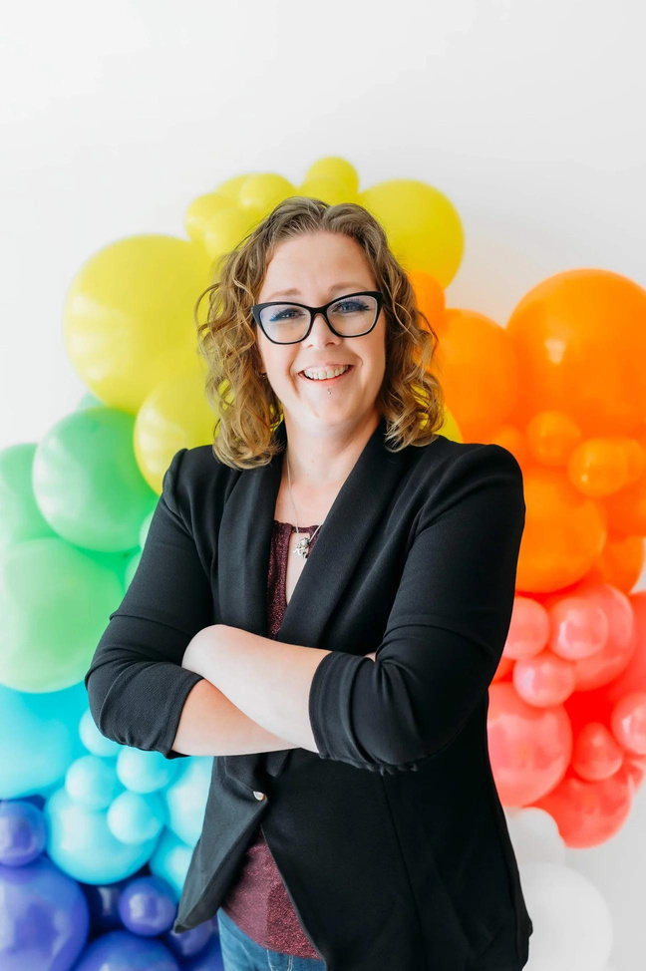
About Fancy Fox Balloons
Bringing a splash of colour and a burst of creativity to every celebration"
  Fancy Fox Balloons: A home-based business specializing in personalized and custom balloon decorations, based in Brockville, Ontario.
  Founder: Kristin Ballantine, a Certified Balloon Artist, founded the company in November 2022, originally named "Love in a Bubble," rebranded to Fancy Fox Balloons in 2023.
  Distinctiveness: Known for stunning, eco-friendly balloon designs, adding a magical touch to all kinds of events.
  Mission: To be the leading local choice for custom balloon decorations in Ottawa, focusing on creativity, premium quality, and sustainability.
02

Slide 3



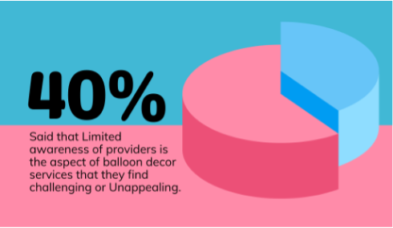
Market Research
Market Insights:
  Global party balloon market valued at USD 1.8 billion in 2022, with a CAGR of 4.0% (2023-2031).
  Post-COVID-19, a resurgence in demand for event decorations, including balloons.
  Growth driven by changing celebration trends, especially in community and corporate events.
Primary Survey Research:
  Key Findings: Preferences for balloon decor usage in personal, corporate, and educational events.
  Budget Insights: Majority spending between $100-$300 on balloon arrangements.
  Influences: High impact of social media, especially Instagram, on hiring decisions.
  Challenges: Limited awareness of providers, demand for variety, and customization options.

Slide 4
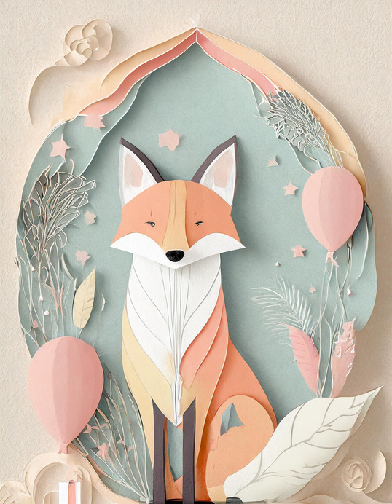

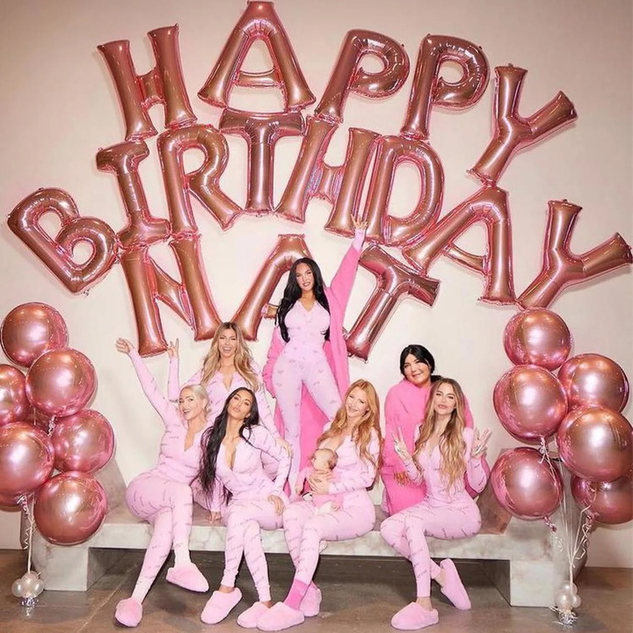
TARGET
MARKET
Primary Target Market:
  Adults aged 25-55, particularly Millennials and Gen X.
  Key Segments: Parents planning children's parties, individuals organizing baby showers, and milestone celebrations (e.g., graduations, anniversaries).
  Geographic Focus: Residents of Ottawa and nearby suburbs.
Secondary Target Market:
  Businesses and educational institutions for corporate events, school celebrations, and promotions.
  Market Valued at $13.2 billion in 2022, expected to reach $21.1 billion by 2028.
  Focus on grand openings, product launches, graduation ceremonies, and corporate events etc.

Slide 5

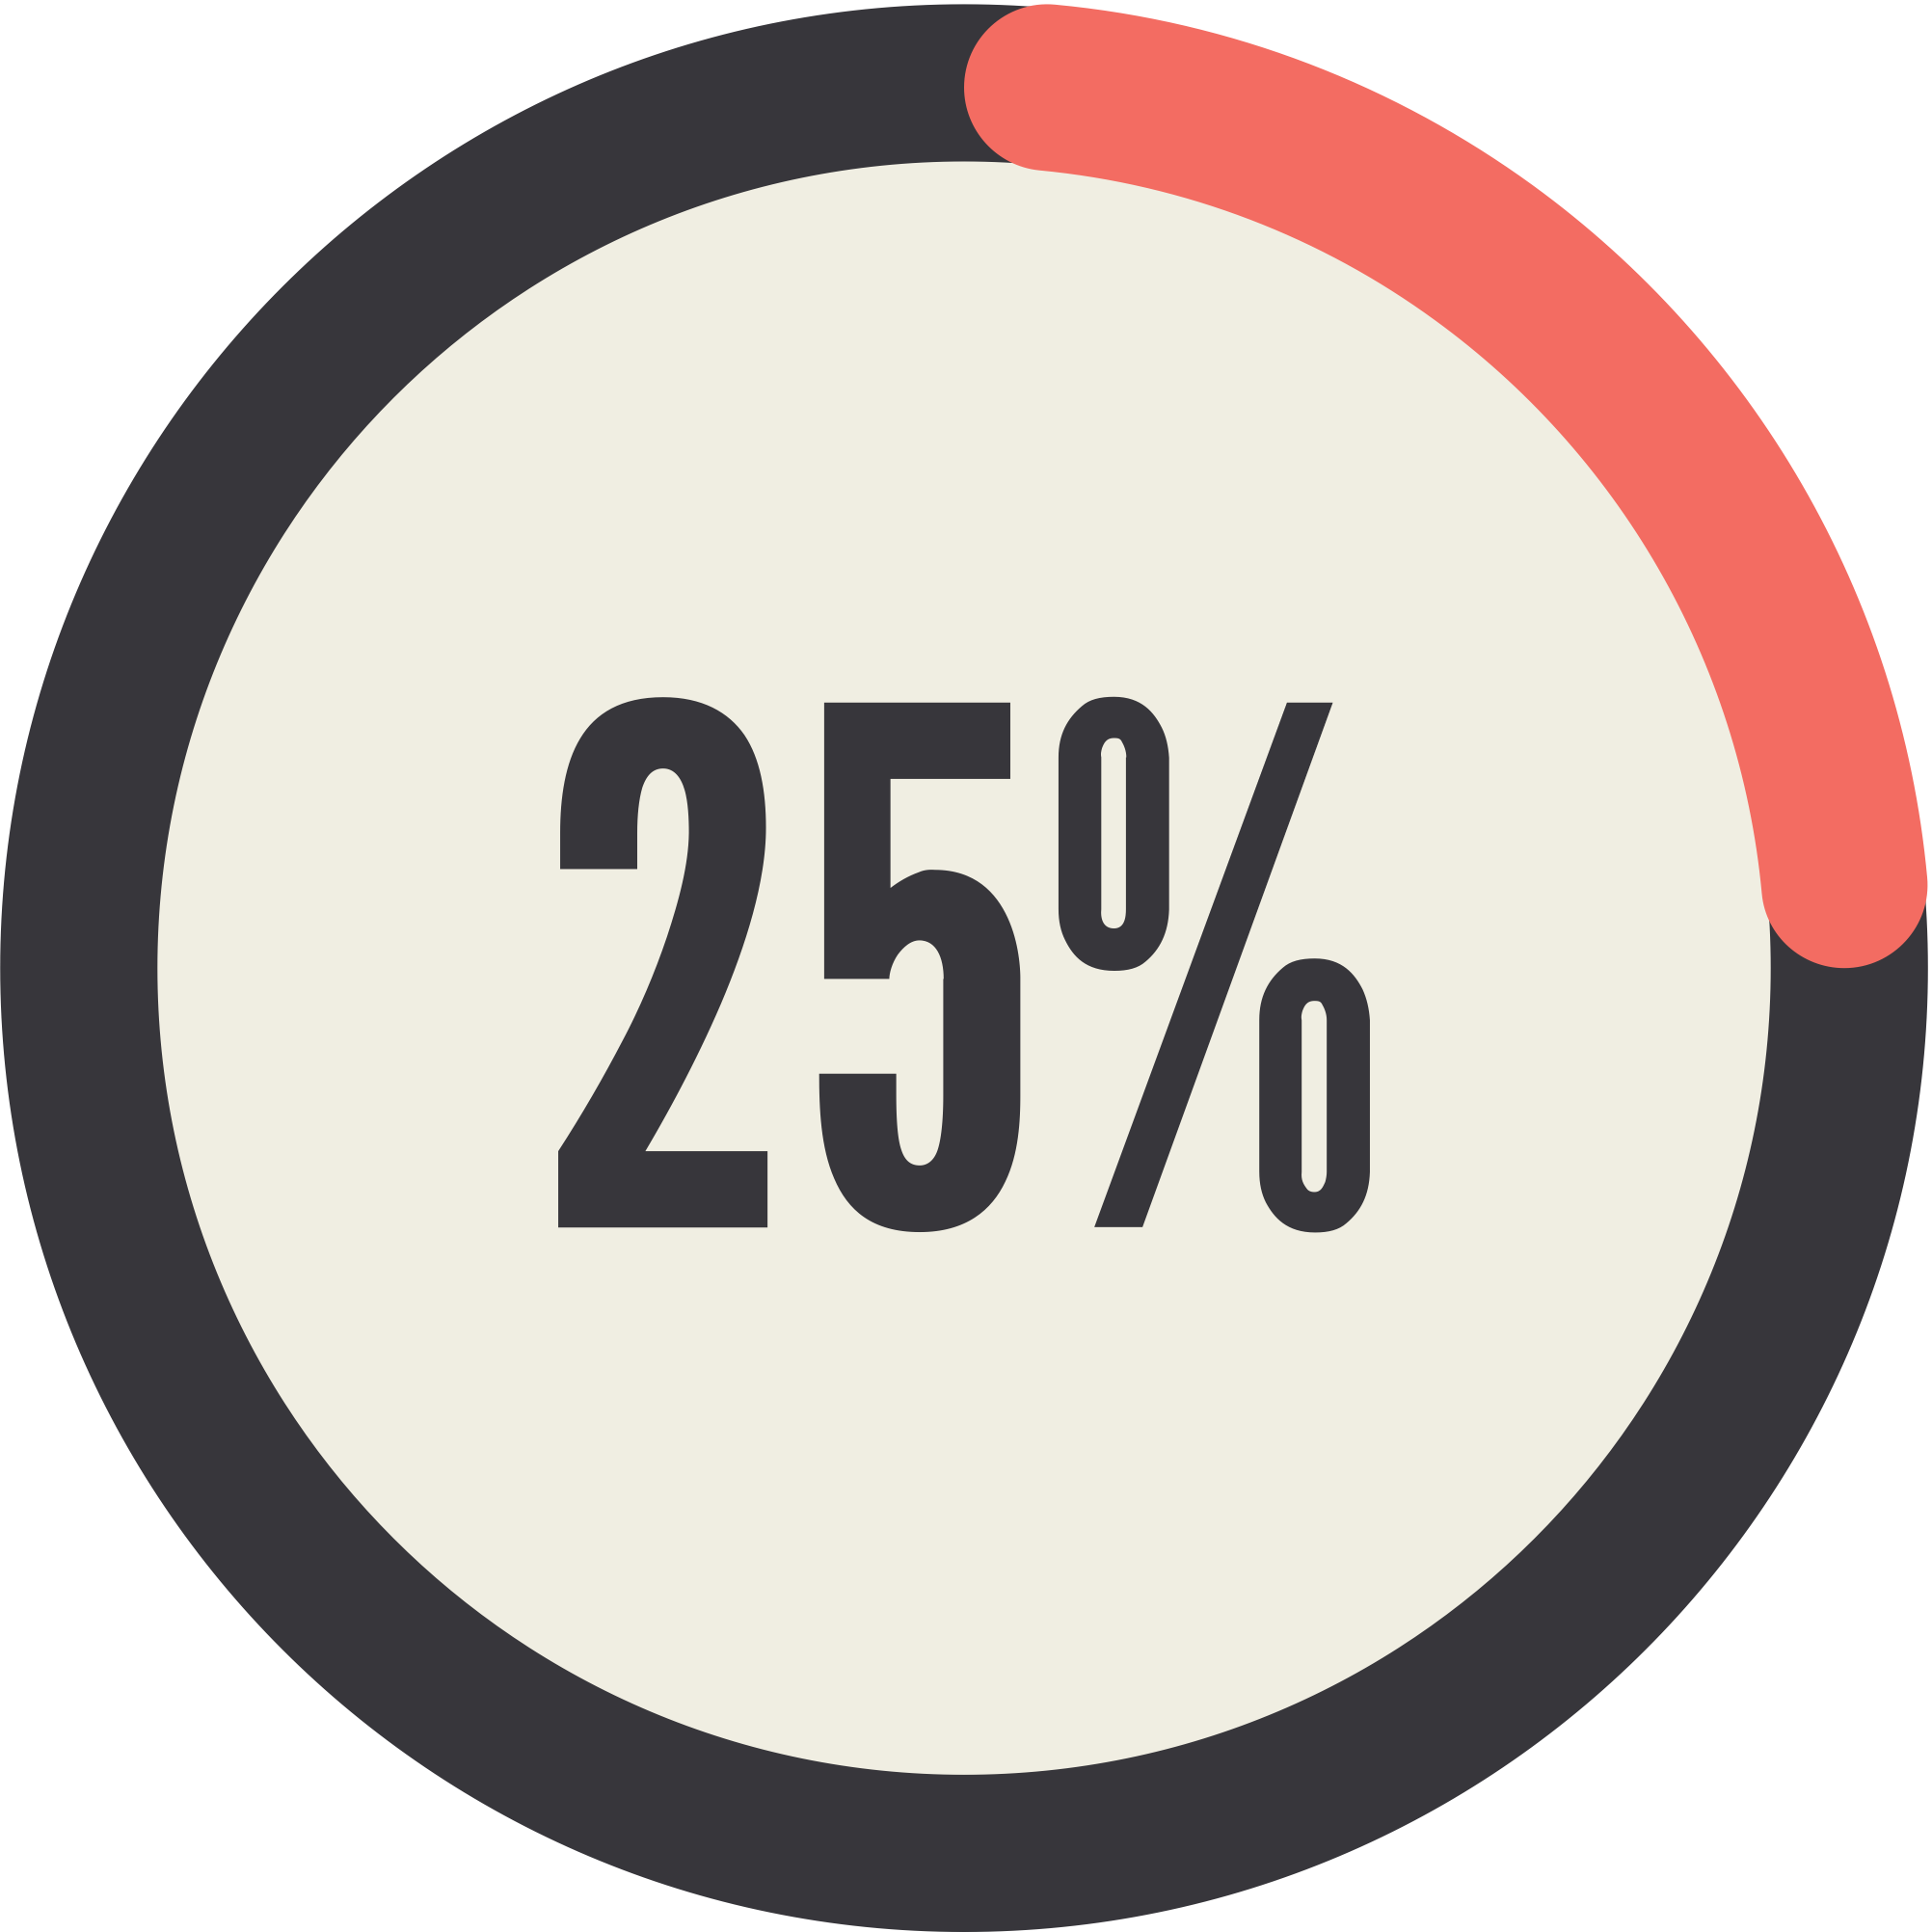
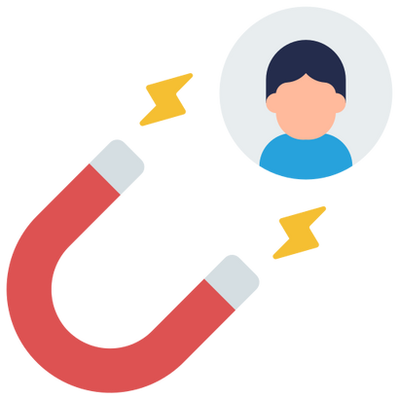
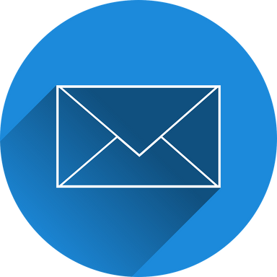
03
Objectives
1
2
3
4
Increase Brand Awareness
  Raise visibility and recognition by 25% among target audience in 6 months
Expand and Strengthen Customer Base
  Expand the customer base, targeting both individuals, corporate, institutional and entertainment industry clients
Drive Sales Revenue
  Generate revenue growth from new customers and upsell/cross-sell opportunities
Build CRM
  Collect Emails For Newsletter

Slide 6
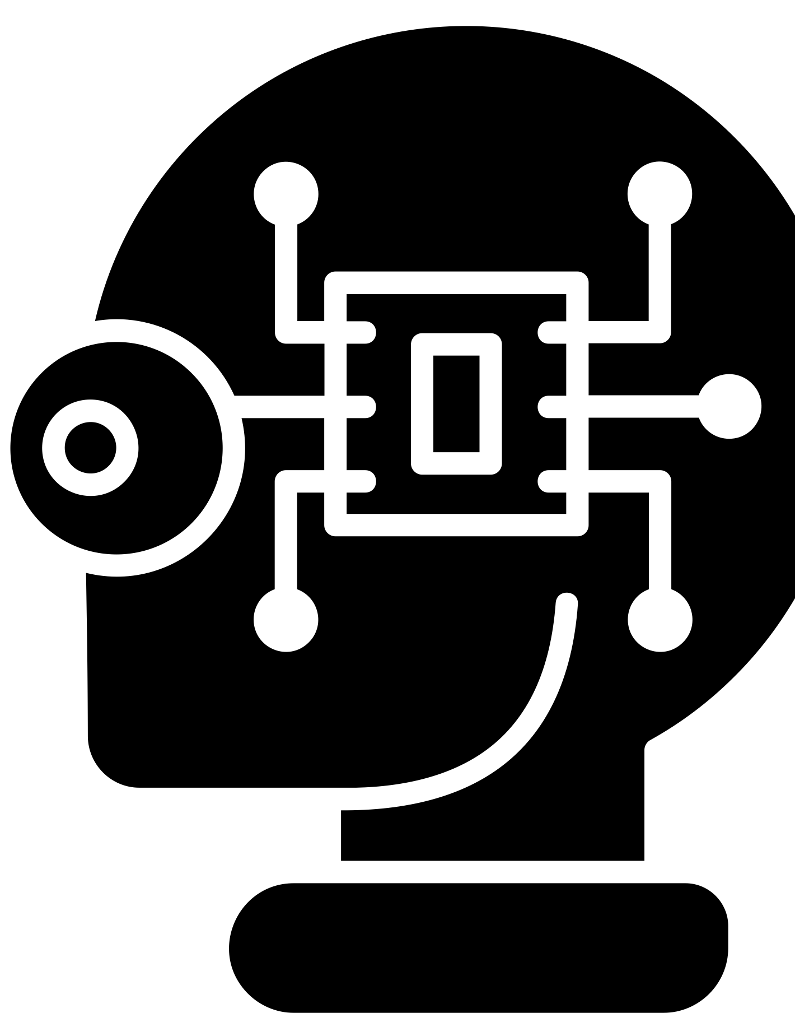
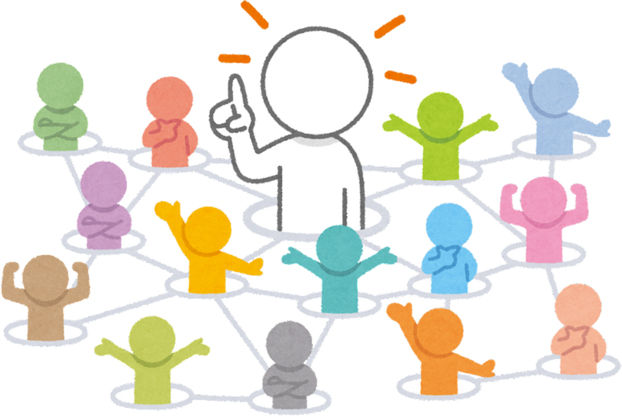
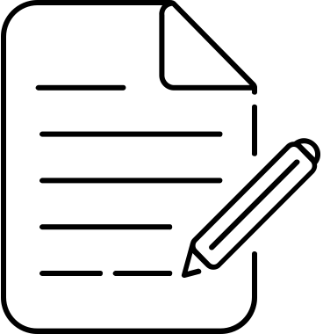
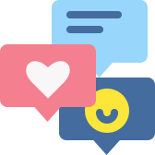
PR Plan
Social Media PR Tactics:
  Develop strong presence on Instagram, Facebook, TikTok
  Share visually compelling content - creations, behind-the-scenes, testimonials
  Engage with audience through comments,Messages, relevant hashtags
  Run social media contests and giveaways for user-generated content
  Collaborate with influencers and local businesses for expanded reach
#foxballoons, #fancyfoxballons
Content Marketing Initiatives:
  Develop blog with valuable insights on event planning, balloon trends
  Publish guest posts/articles on relevant industry platforms
  Create infographics, videos and other multimedia content assets
  Implement consistent content scheduling and promotion
Influencer and Community Outreach:
  Identify and partner with local influencers, bloggers, event planners
  Offer complimentary services for events/photoshoots in exchange for promotion
  Participate in community events, festivals, markets for visibility
  Explore partnerships with venues, vendors, charities for cross-promotion

Slide 7
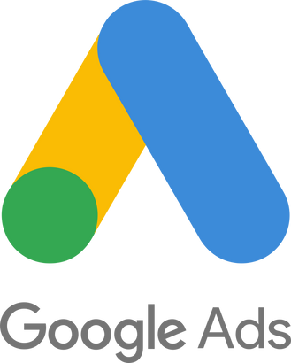
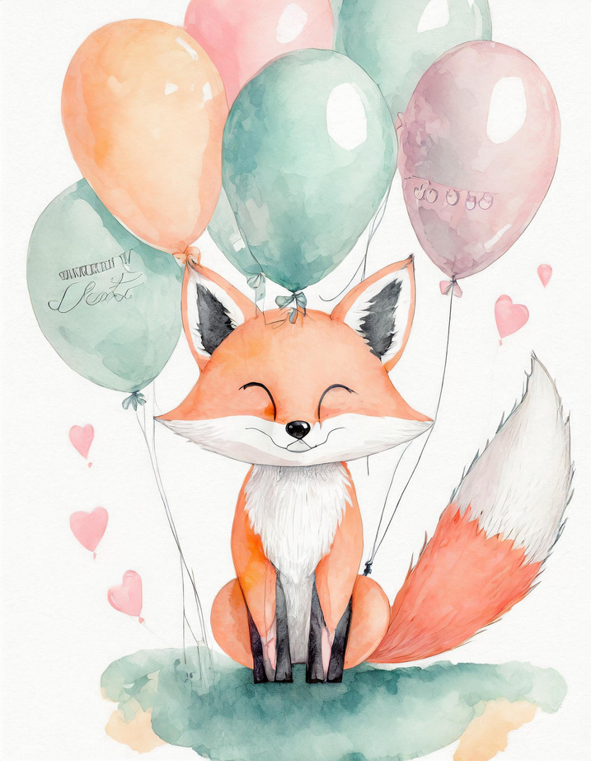
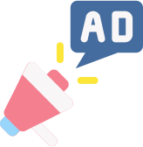
Social Media Ads (Facebook, Instagram, TikTok)
Search Engine Marketing (Google Ads)
ADVERTISING
Plan
  Targeted ads based on demographics, interests, behaviors
  Leverage cost-effective ad formats like boosted posts, stories
  Target relevant keywords for local balloon decor searches
  Optimize ad copy and landing pages for higher conversions
Local Online Directories for eg (Yelp, Yellow Pages)
Traditional Earned Media (Newspapers, Magazines)
  Claim and enhance listings for greater local visibility
  Explore advertising opportunities in local Ottawa publications

Slide 8
Digital Plan
Email Marketing and Lead Generation:
  Build email subscriber list via website, social media, in-store sign-ups
  Send monthly newsletters highlighting new offerings, promotions, tips
  Utilize email automation for personalized customer journeys
  Capture leads through clear calls-to-action and lead magnets
LinkedIn Strategy:
  Create and optimize a company page showcasing balloon decor expertise
  Share portfolio, customer testimonials, industry insights
  Connect with local businesses, event planners, relevant groups
  Explore targeted advertising to reach corporate clients
  Encourage endorsements and recommendations from corporate customers
Website Optimization:
  Conduct website audit for user experience
  SEO optimization to grow organically
  Optimize content and meta tags for relevant keywords
  Enhance website speed and performance
  Implement clear calls-to-action for inquiries, quotes, and sign-ups

Slide 9
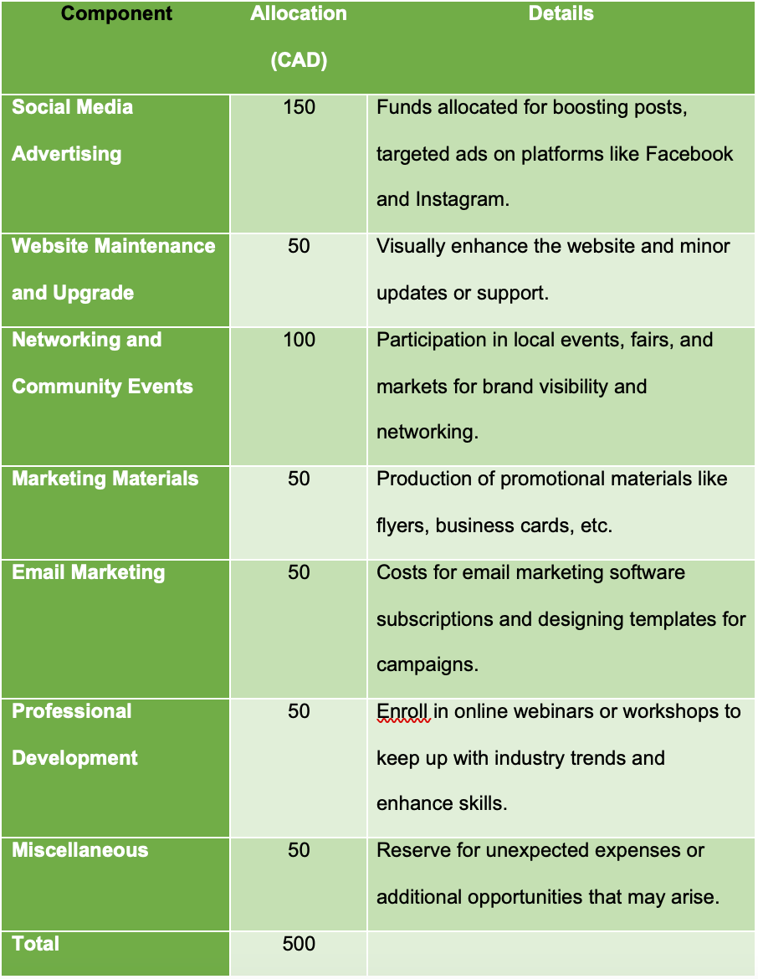
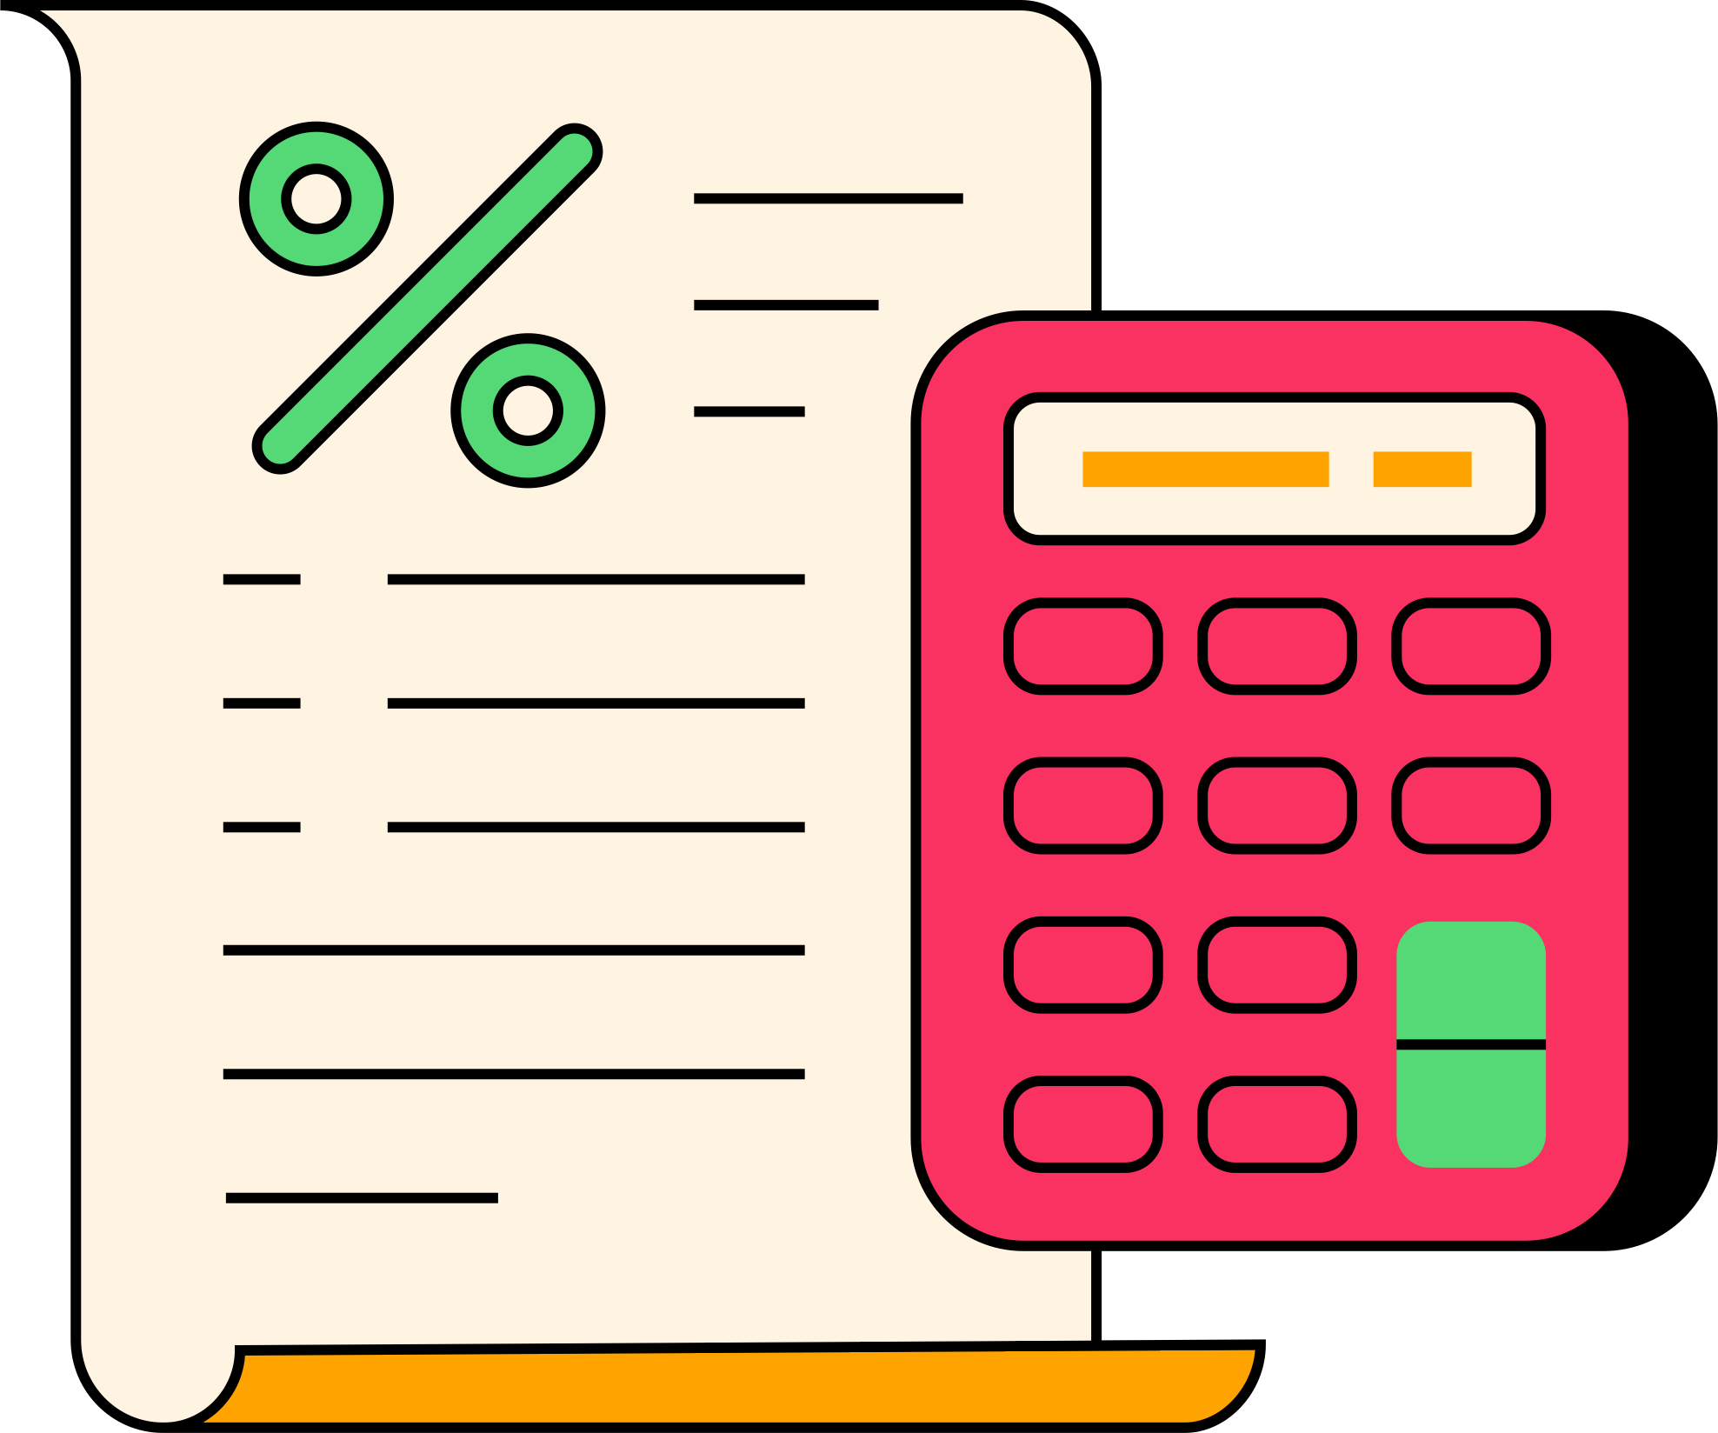
BUDGET & TIMELINE
Phase 1 (Months 1-2):
  Social media content creation and influencer outreach
  Website audit and optimization plan
  Email template design and campaign planning
  Community event research and guest post ideation
  Seasonal promotion planning and referral program setup
Phase 2 (Months 3-4):
  Launch Google Ads, social media ads.
  Blog post writing and publishing
  Email campaign execution and monitoring
  Influencer collaboration promotion and community event participation
  Bundle deals promotions and landing page development
Phase 3 (Months 5-6):
  Evaluate influencer collaborations and plan new partnerships
  Online reputation management and review responses
  Email list segmentation and targeting optimization
  Flash sale promotion and loyalty program refinements
  Ad performance review and budget reallocations

Slide 10



BENEFITS TO THE COMPANY
Enhanced Brand Visibility
Expanded Customer Base
Increase Revenue
Long-Term Sustainability

Slide 11
Thank you!

