Slide 1




WELLCOME
Kritika Sobti

Slide 2

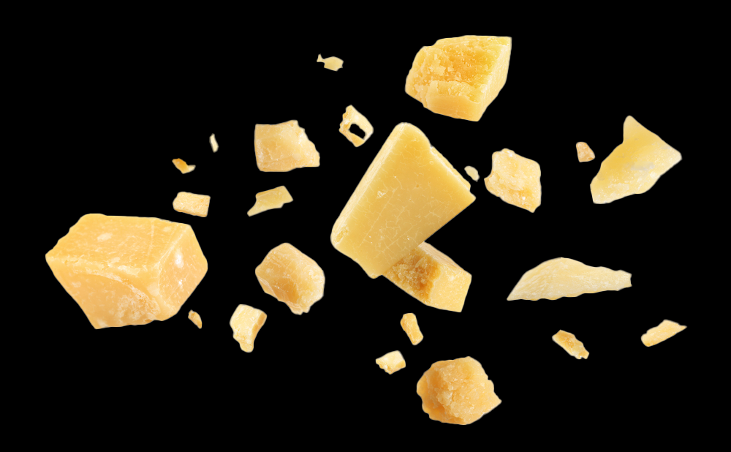
Introducing Yummivita Gummies
A Savory Revolution in Multivitamins
Enhanced Absorption Formula
Natural and Healthy
Innovative Flavor

Slide 3

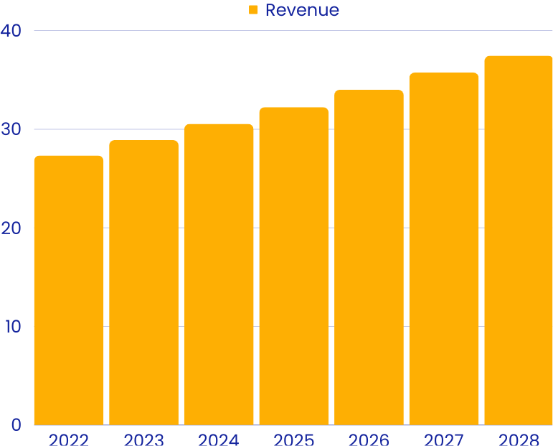
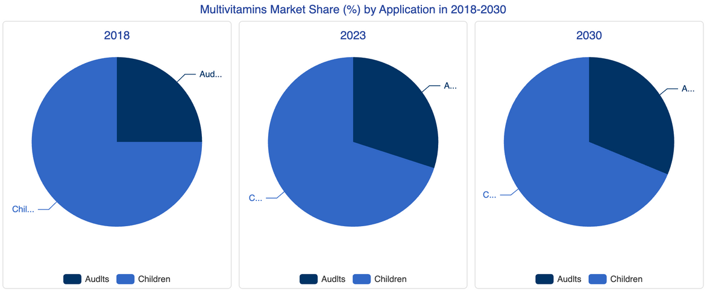
Market Analysis
  Target Market: Health-conscious adults seeking savory supplement options.
  Growing Demand: Increase in preference for natural and unique-flavored health products.
  Competitive Edge: Yummivita's unique cheese flavor sets it apart in the multivitamin market.
Vitamins & Minerals - Canada

Slide 4
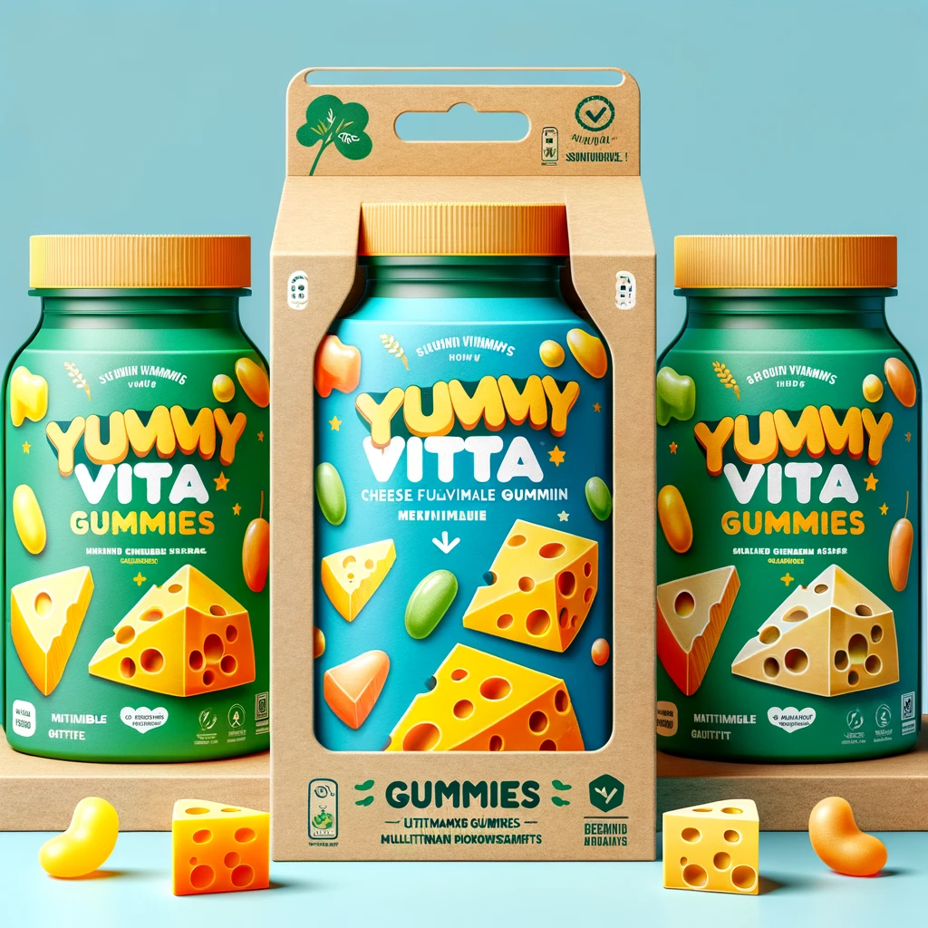



The Development Journey of
Yummivita Gummies
Ingredients and Sourcing
  Natural cheese powder
  Vitamins A, C, D, E, B complex, Calcium, Iron, Magnesium (NutraLab)
Production Costs
  Fixed and Variable Costs
  Unit Production Cost: $2.50
Packaging
  Eco-Friendly Bottles
  Vibrant Label Design

Slide 5


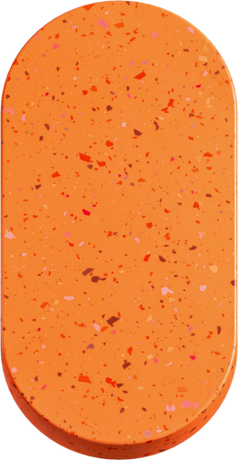


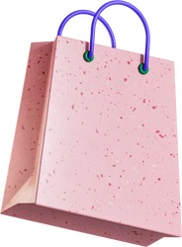



BRANDING AND MARKETING
STRATEGY
Brand Identity
Brand Identity: Yummy + Vita = Delicious, Healthy Living
USP: Unique Cheese Flavor in a Vitamin
USP
Marketing Mix (4P’s):
Marketing Mix (4P’s):
Product
Price
Place
Promotion

Slide 6




SUPPLY CHAIN AND HR
01
Supply Chain Management:
  Partners: Hilmar & NutraLab for Quality Ingredients.
  Tech-Advanced Manufacturing; Sustainable Sourcing
02
Human Resources:
  Competitive HR: Salaries, Benefits, Training.
  Culture: Creativity, Teamwork, Learning

Slide 7


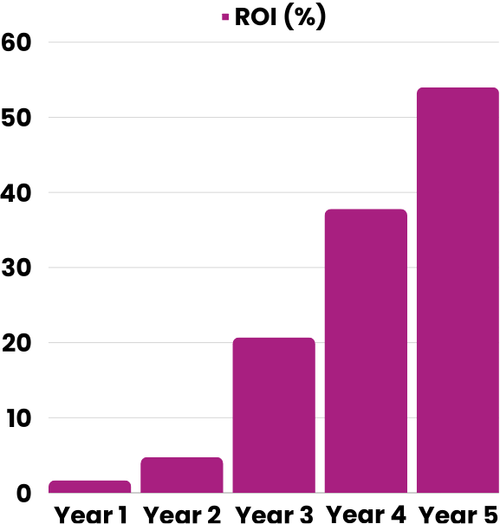
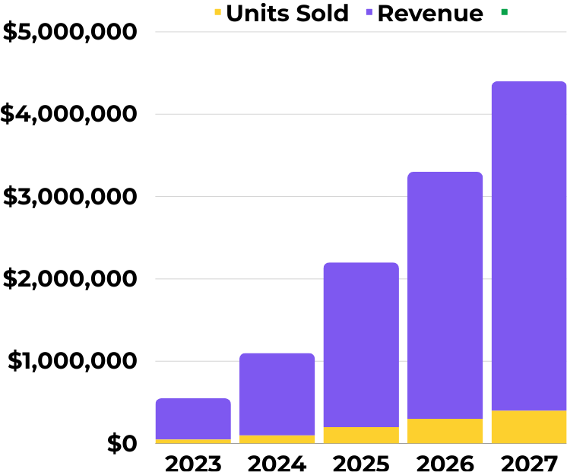

FINANCIAL PROJECTIONS
ROI

Slide 8




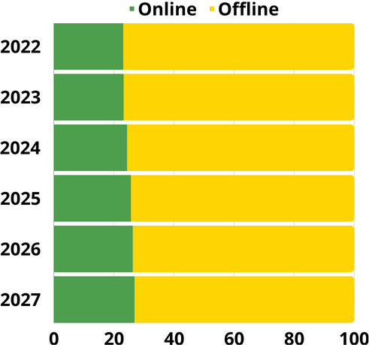
Launch Regions: Manitoba, Ontario, Saskatchewan, Alberta, British Columbia
DISTRIBUTION STRATEGY
Retail Presence: Select Stores Across Canada
YUMMIVITA
GUMMIES
E-Commerce: Available on Yummivita Website
Distribution Flow: Producers → Retailers → Consumers
Market Insight: 76.8% Offline Revenue Share

Slide 9
MONTHS 1-3 PRODUCT & PACKAGING FINALIZATION | MONTHS 4-6 MARKETING CAMPAIGN LAUNCH | MONTH 7 OFFICIAL PRODUCT LAUNCH | Months 8-12 Distribution Expansion | Year 1 $500,000 Revenue
5
TIMELINE AND MILESTONES
4
3
2
1

Slide 10



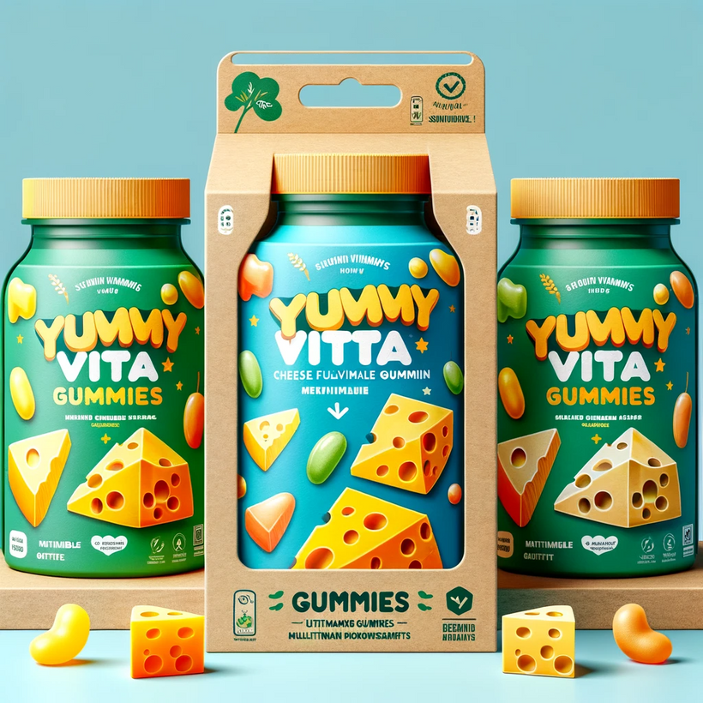
THANK YOU!
  Yummivita Gummies: A Revolution in Nutritional Supplements."
  Innovative Flavor, Strategic Marketing, and Efficient Distribution."
  Committed to Quality, Sustainability, and Consumer Health
We welcome your questions and feedback

